Slide 1
From Growing the Digital World … to Growing Up in the Digital World
Katherine T. Cost, PhD
Psychiatry & Behavioural Neurosciences
McMaster University
Hamilton, Ontario, Canada

Slide 2
Disclosures
Research funding:
  Canadian Institutes of Health Research
  The Hospital for Sick Children Psychiatry Associates
Personal financial disclosures:
  None
Family relationships:
  None

Slide 3
Agenda
Growing the
Digital World
How did we get here ?
Screens today
Growing Up in the Digital World
Screentime, eating during screentime,
and parenting stress
Patterns of parent screen use
Pandemic screentime & mental health
Living in the
Digital World
For individuals & families
For clinicians
For policy-makers
For researchers

Slide 4
Growing the
Digital World
Communications technology yesterday & today

Slide 5
How did we get here?
Communications Technology
1837 Commercial electrical telegraph
1867 Telephone patented
1900 Commercial radio
1911 Airmail
1965 TV broadcasts in colour
1967 “The internet” (TCP/IP)
1983 Apple Personal Computer; Motorola DynaTAC mobile phone
1991 World Wide Web (http)
1999 BlackBerry Personal Digital Assistant
2005 YouTube debuts; videochat in instant messenger services with webcams
2007 Apple iPhone; Netflix on-demand video streaming launches
2010 Apple iPad

Slide 6
How did we get here?
Communications Platforms
2006 Facebook, twitter
2010 Instagram, Pinterest
2011 snapchat
2013 8chan
2015 Discord
mid-2010’s “influencer” becomes a lucrative job
2016 TikTok
2022 twitter becomes X
2022 ChatGPT

Slide 7


Screens today
Uptake
Global Smartphone
Ownership
2023¹
Global Internet Access
2023²
The Lancet Regional Health-Americas. Screen violence: a real threat to mental health in children and adolescents. Lancet Reg Health Am. 2023 Mar 9;19:100473. doi: 10.1016/j.lana.2023.100473. PMID: 36950035; PMCID: PMC10025407.
https://www.statista.com/statistics/617136/digital-population-worldwide/

Slide 8

Screens today
Benefits
Entertainment
Relieve stress
Regulate boredom
Increase productivity
Learn new skills
Access to information resources
Stay connected to family & friends
Watching movies, listening to music
Meditation apps
Nature scenes
Distraction during difficult conditions
Something to do while waiting in
line-ups
Work productivity
Work from home
Online shopping/delivery
Online banking
Learn a language
How-to’s on YouTube
News, research databases, wikipedia
Text messages, email, video-chat

Slide 9
Screens today Harms
Phubbing: disrupting an in-person interaction to engage in a virtual interaction
Decrease face-to-face interactions
Distraction during tasks
Phubbing
Technoference
Sexting, online grooming
Rumors, propaganda,
misinformation, disinformation
Addiction/dependence
Developmental delays
Displacing other activities (sleep, physical activity)
Physical health problems
Technoference: difficulty doing or completing tasks because of interruptions from notifications on a device
Sexting: sending sexually explicit photos or messages on a mobile device
Online grooming: adult who builds an emotional and trusting relationship with children through online platforms to exploit and abuse them
Rumors: info not attributable to a source
Propaganda: biased or misleading information to promote a political point of view or cause
Misinformation: incorrect or misleading information
Disinformation: false information deliberately spread to deceive

Slide 10






Screens today
Guidelines
< 18 or 24 months
no screen time
2-5 years
< 1 hour
co-viewed, educational & high-quality, or video-chat
Co-viewing:
watching programming together;
discussing, prompting, asking child questions about show
🇫🇷
Educational & high-quality
18+ years
commercial social media
Parents
limit screens in maternity wards,
phone use “should be addressed” among childminders
6+ years
  “limit digital media time”
  “encourage healthy habits & limit screen activities”
  “Media mentor: teach children how to use digital media as a tool to create, connect, and learn”

Slide 11
Screens today
Regulation
Internet exceptionalism
Unfettered freedom of speech, minimal government regulation, private-sector development of content & services, preference for market-based solutions over state intervention
Platform exceptionalism
Companies create algorithmically-enabled, content-curated environment for commercial gain while simultaneously claiming they operate as neutral providers of communication & ideas
https://www.cigionline.org/articles/battling-the-myths-of-internet-regulation-as-we-consider-the-next-iteration-of-bill-c-10/

Slide 12

Screens today
Regulations
EU Digital Services Act 2022
to prevent illegal and harmful activities and disinformation online
to ensure user safety
to protect rights
to create a fair & open online environment
Age to join most social media platforms:
13 years old
Children’s Online Privacy Protection Act 1998
  U.S. law around child privacy
  Federal TRADE Commission
  …not Federal Communications Commission
  …not U.S. Public Health Service
Bill C-63: The Online Harms Act 2024
to hold social media services accountable for reducing exposure to harmful content
to prevent and deter hate crimes and hate propaganda offences
to allow recourse to the Canadian Human Rights Commission against individual users who post hate speech
to require reporting of child pornography online by persons who provide an internet service
https://www.ftc.gov/legal-library/browse/rules/childrens-online-privacy-protection-rule-coppa
https://www.justice.gc.ca/eng/csj-sjc/pl/charter-charte/c63.html
https://commission.europa.eu/strategy-and-policy/priorities-2019-2024/europe-fit-digital-age/digital-services-act_en

Slide 13
Screens today
Research
Instruments
Time by device/modality
Time on content type
Time on active use,
time on passive use
Time of day
Bespoke apps to record usage
Screenshot of endogenous screentime apps
Measurement Error
Self-report & Parent-report
Social desirability bias
Lack of awareness
Non-representative sample
Inaccurate screenshot
Technological capacity
Questionnaire length
Ethics
Questionnaire length
Invasive
Identifiable information

Slide 14
Growing the
Digital World
Communications technology & platforms are changing rapidly
Screens can have many benefits for individuals and even societies, but they can also present harms in new ways
Communications technology has had
little regulation, but that is changing
Current guidelines mainly focus on younger children
Accurate & ethical research on the benefits and harms of screen time and content presents challenges

Slide 15
Growing Up in the
Digital World
Screens in family life and early childhood

Slide 16
Screentime, Eating during Screentime, & Parenting Stress
Sample
Cross-sectional, convenience
Infants 7-18 months
N = 1085
November 2011 – July 2018
Measures
Parenting Stress Index
Household income
Child sex at birth
Child Negative affect (IBQ)
Average minutes of child screen exposure per week
Average count of meals during screen exposure per week
Hypotheses
Higher parenting stress
Higher child negative affect
Older child age
Single parent homes
Lower household income
+
child screen exposure
Statistical Methods
Zero-inflated negative binomial models
+
child meals during screen exposure
Tombeau Cost K, Korczak D, Charach A, et al. Association of Parental and Contextual Stressors With Child Screen Exposure and Child Screen Exposure Combined With Feeding. JAMA Netw Open. 2020;3(2):e1920557. doi:10.1001/jamanetworkopen.2019.20557

Slide 17
Screentime, Eating during Screentime, & Parenting Stress
Child Screen Exposure
Any vs. None
Higher parenting stress
Older child age
Of those with screen exposure:
59 min screen exposure per day
More vs. Less
Higher parenting stress
Lower household income
No screen exposure
Screen exposure
Tombeau Cost K, Korczak D, Charach A, et al. Association of Parental and Contextual Stressors With Child Screen Exposure and Child Screen Exposure Combined With Feeding. JAMA Netw Open. 2020;3(2):e1920557. doi:10.1001/jamanetworkopen.2019.20557

Slide 18
Screentime, Eating during Screentime, & Parenting Stress
Child Meals during Screen Exposure
Any vs. None
Older child age
Lower household income
Of those who ate meals during screen exposure:
4.4 meals during screen exposure per week
More vs. Less
Lower household income
No meals during screen exposure
Meals during screen exposure
Tombeau Cost K, Korczak D, Charach A, et al. Association of Parental and Contextual Stressors With Child Screen Exposure and Child Screen Exposure Combined With Feeding. JAMA Netw Open. 2020;3(2):e1920557. doi:10.1001/jamanetworkopen.2019.20557

Slide 19
Patterns of parent screen use
Research Aims
To identify patterns of TV and handheld screen use by parents
To identify parent sociodemographic characteristics associated
with patterns
To examine associations between patterns of parent screen use and child screen time and child socio-emotional problems
Sample
Cross-sectional, convenience
Parents of 5-6 yr old children
N = 867
January 2014 – December 2019
Measures
Data collection year
Household income
Single parent household
Parent sex at birth
Parent average minutes per day of TV/DVD
Parent average minutes per day of handheld
Child average minutes per day of total screentime
Child socio-emotional problems (Strengths & Difficulties Questionnaire)
Statistical Methods
Latent Profile Analysis
Wald tests (3-step BCH method)
Cost KT, Unternaehrer E, Tsujimoto K, et al. Patterns of parent screen use, child screen time, and child socio‐emotional problems at 5 years. Journal of neuroendocrinology. 2023;35(7):e13246.

Slide 20
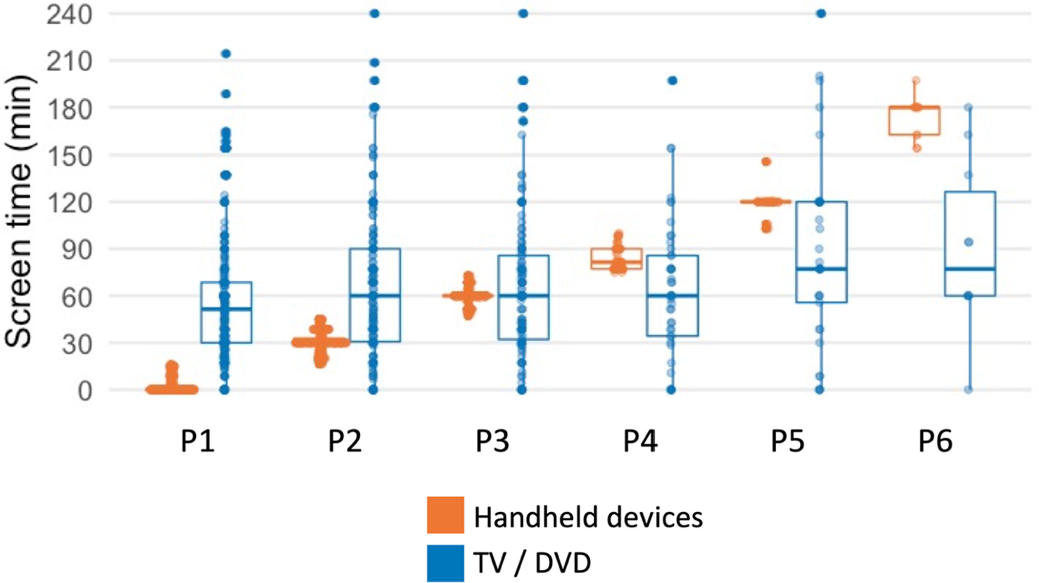
Patterns of parent screen use
P6
Single parents
Higher child social-emotional
problems
Parent Screen Use Patterns
P5
Higher child screentime
P4
Low income
Higher child screentime
P2
Low income
Cost KT, Unternaehrer E, Tsujimoto K, et al. Patterns of parent screen use, child screen time, and child socio‐emotional problems at 5 years. Journal of neuroendocrinology. 2023;35(7):e13246.

Slide 21
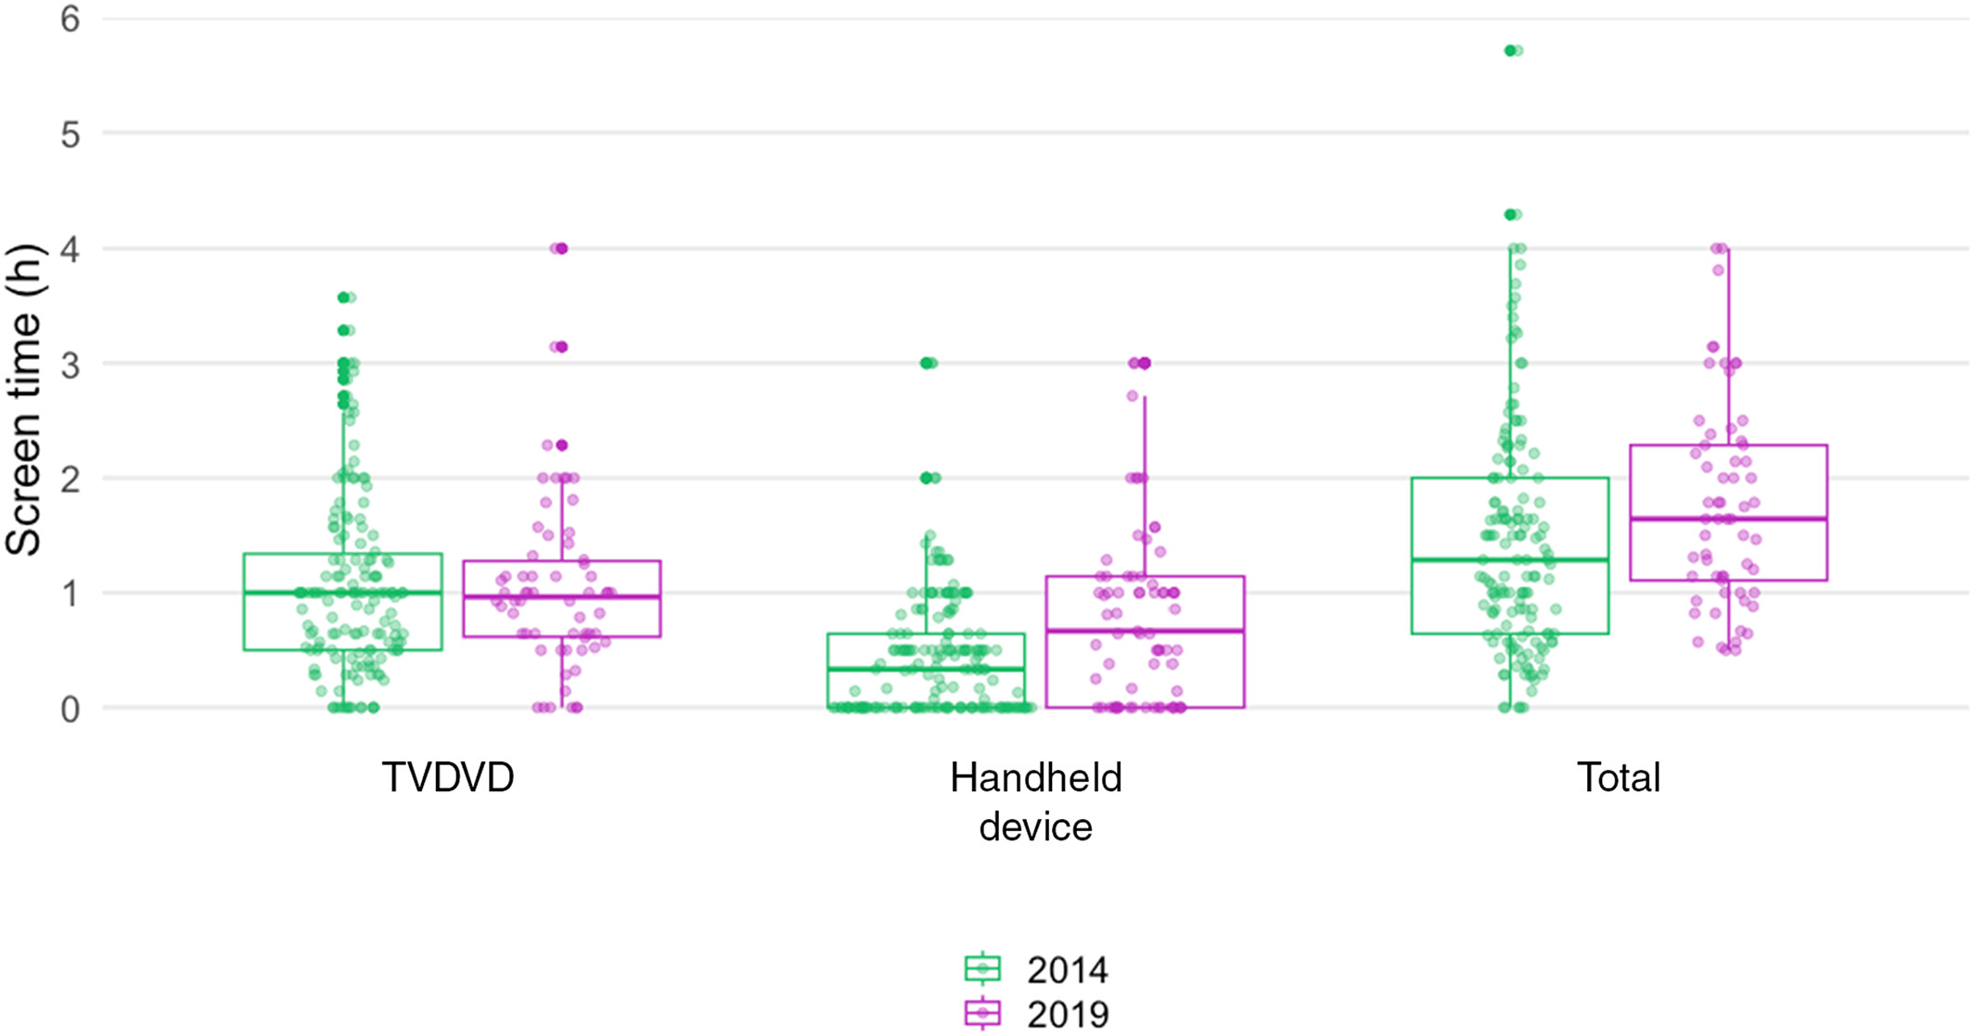
Patterns of parent screen use
Temporal Changes in Parent Screen Use
2014
61.8 min/day on TV/DVD
26.9 min/day on handheld
9.6% exceed 3hrs/day
2019
61.6 min/day on TV/DVD
48.2 min/day on handheld
14.8% exceed 3hrs/day
Cost KT, Unternaehrer E, Tsujimoto K, et al. Patterns of parent screen use, child screen time, and child socio‐emotional problems at 5 years. Journal of neuroendocrinology. 2023;35(7):e13246.

Slide 22
Pandemic Screentime & Mental Health
Research Aims
To determine whether specific types of screen use:
  TV/digital media
  video games
  electronic learning
  video-chatting
  were associated with child mental health symptoms
Sample
Cross-sectional, convenience
Parents of 2-4 yr old children
N = 140
May 2020 – April 2021
Measures
Calendar date
Household income
Child race & ancestry
Child sex at birth
Child average minutes per day
  TV/digital media
  Videogames
  electronic learning
  video-chatting
Strengths & Difficulties Questionnaire
  Conduct problems
  Hyperactivity
Statistical Methods
Linear mixed effects models
Li X, Vanderloo LM, Keown-Stoneman CDG, Cost KT, et al. Screen Use and Mental Health Symptoms in Canadian Children and Youth During the COVID-19 Pandemic. JAMA Netw Open. 2021;4(12):e2140875. doi:10.1001/jamanetworkopen.2021.40875

Slide 23





Pandemic Screentime & Mental Health
TV/digital media
84.2 min/day
Video-chatting
21.9 min/day
Associations with Child Mental Health
More time spent on TV/digital media was associated with higher Conduct Problems
Electronic Learning
6.5 min/day
Video games
6.4 min/day
1 hr, 59 min per day
** descriptives on screen time by type in 2-4 year olds are unpublished data
Li X, Vanderloo LM, Keown-Stoneman CDG, Cost KT, et al. Screen Use and Mental Health Symptoms in Canadian Children and Youth During the COVID-19 Pandemic. JAMA Netw Open. 2021;4(12):e2140875. doi:10.1001/jamanetworkopen.2021.40875

Slide 24
Growing up in the
Digital World
Most children are exposed to screens at very young ages
Infant & child screen exposure
is related to contextual variables
Parent screentime is increasing temporally,
driven by increases in time on handheld devices
More time on
TV/digital media during the pandemic was associated with more conduct problems
Parent screen time is associated
with child screentime
and with child behaviour problems

Slide 25
Living in the
Digital World
For individuals, researchers, clinicians, and policy-makers

Slide 26
Living in the
Digital World
Individuals
Introspection
why am I using my screen(s) right now?
Escapism?
Productivity?
Connection?
Stress relief?
Check yourself
Apple:
Screentime
Android:
Digital Wellbeing
What apps are you using and does your time
on those apps contribute to your happiness?
How to check your screentime Apple: https://support.apple.com/en-ca/guide/iphone/iphbfa595995/ios
How to check your screentime Android: https://support.google.com/android/answer/9346420?hl=en

Slide 27
Living in the
Digital World
Family Level: younger kids
What is your family “screen culture” ?
Use screens to branch off into
real-world connection
Check yourselves
Weekly check-ins on screen time
Explain yourself
  Doing better together
  Not to blame/punish, about regaining agency
  About caring, teaching, and learning
Build in screen-free times: meals, car, bedtime

Slide 28
Living in the Digital World
Researchers
  Measure what can be measured; make measurable what cannot be measured.
  - attributed to Galileo Galilei
Measurement
Time: hours per day
Modality: handheld or large/shared screen
Engagement: passive or active
Platform: TV/movies, digital content, websites, gaming, social media, AI-related
Content: connection, educational, escapist, algorithmic, problematic
Context: phubbing, technoference, during school, before bed

Slide 29
Living in the Digital World
Clinicians
Child Screentime
Many infants and children are exposed to screens
Related to contextual limitations, parent stress,
& parent screentime
Child Behaviour Problems
Have been associated with child screentime
Have been associated with parent screentime
Directionality ?
Screens are not a sustainable solution to manage
behaviour or dysregulation

Slide 30
Living in the Digital World
Policy-makers
Regulations
  Not easy, but gaining traction in some jurisdictions
Digital Media Education
  Schools, libraries, and other public spaces
  How to spot a reputable source
  Digital citizenship, developing identity
What’s the (safe, affordable) alternative?
  High-quality, affordable daycare for youngest children
  Parks & outdoor spaces for young children
  School clubs & sports for older children

Slide 31
Thank you !
Merci !
Vielen Dank!
Parents & children who participated
Eva Unternaehrer, PhD
Piyumi Mudiyanselage, MSc
Alice Charach, MD
Charles Keown-Stoneman, PhD
Catherine Birken, MD
Jonathon Maguire, MD
Xuedi Li, MSc
Leigh Vanderloo PhD
Peter Szatmari, MD
Kathy Georigades, PhD
Emma Nolan, PhD
Nicole Dryburgh, PhD
Andrea Krishnapillai, PhD
Li Wang, PhD
Tak Shibayama, MSc
Lindsay Grenier
Kate Jamieson
Linda Duong
Ryan Miller
Katherine T. Cost, PhD
costk@mcmaster.ca

